Slide 1
Oregon Army National Guard (ORARNG)
Common Birds of Rees Training Area

Slide 2
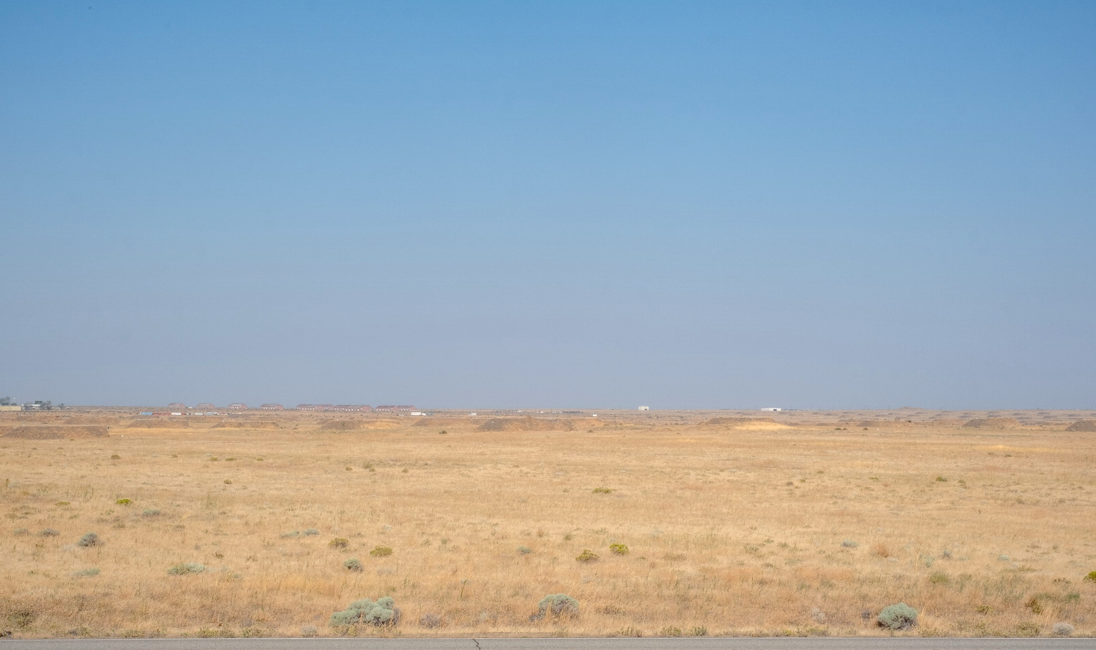
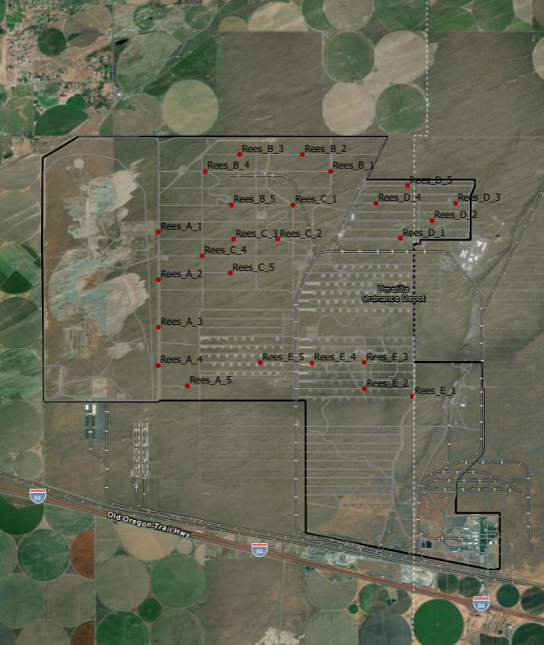
Habitat
Great Basin grassland
Dominated by invasive annuals (e.g., cheatgrass, mustards), intermixed perennial bunchgrass
Sparse shrub (e.g., sagebrush, rabbitbrush)
Enclosed by ag
Notes:
Umatilla:
- Fort Oregon Master Plan underway. Next round of planning meetings scheduled for next week.
- Waterline project that connects Well #6 & Well #7 to cantonment area has been awarded. Construction of replacement for Well #1 has been funded and project awarded. Dispute with OWRD and OHA on repurposing Well #2.
- $9.3M MILCON Barracks and $2M SRM Barracks are under design for FY’21 construction. Draft NDAA includes additional $15.735M Barracks for FY/21 execution.
Salem Area Space Plan: Selection of Design-Build contractors underway for November award.
BOS SAG 131 UFR: Presently estimated to be $2.9M. Awaiting release of NGB CR Withhold.
21-23 Biennium State Budget: O&M Program directed to prepare two separate 10% budget reduction plans. If exercised, would result in $1M plus reduction. Bonding requests submitted for ASLEPs/RAEEPs at Kliever, Ashland, McMinnville, and Corvallis.
COVID-19 Impact to Armory rentals: Social distancing restrictions have resulted in revenue losses of $180,337 over the same period last year. Non-essential State expenditures continue to be deferred.

Slide 3
Common Bird Identification

Slide 4
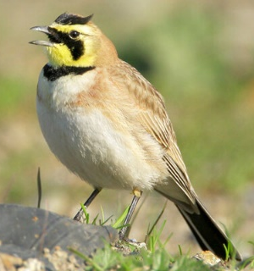
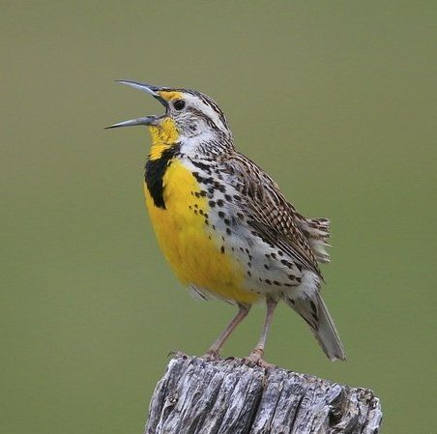
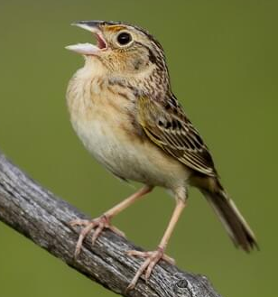
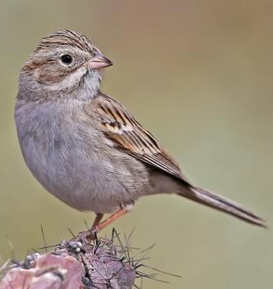
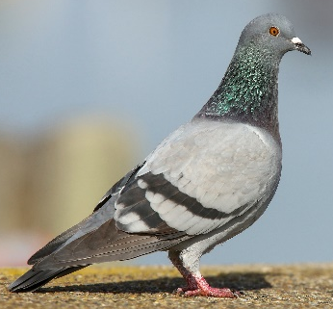
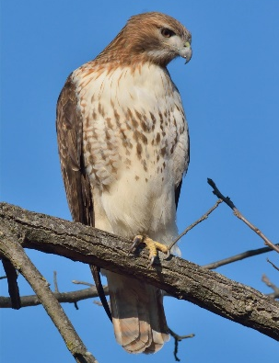
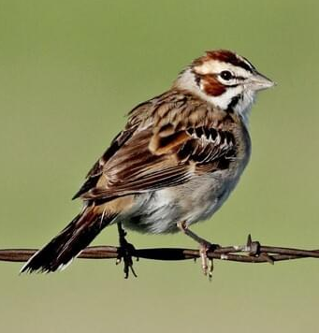
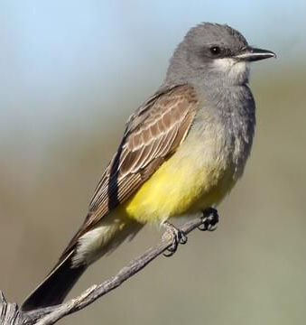
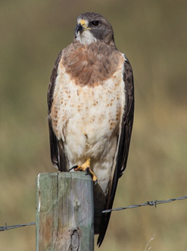
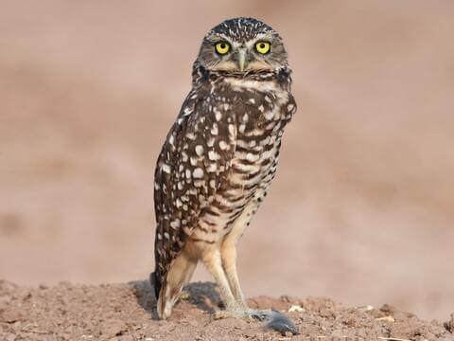
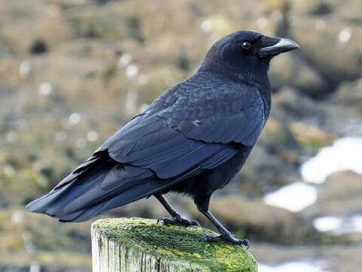
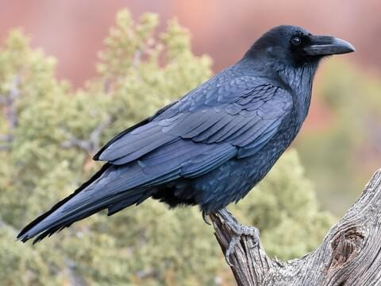
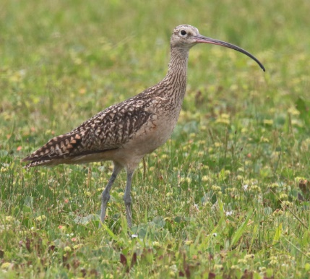
Common Birds of Rees TA
horned lark
Western meadowlark
grasshopper sparrow
Brewer’s sparrow
rock pigeon
lark sparrow
Western kingbird
sage thrasher
California quail
mourning dove
red-tailed hawk
American crow
common raven
Swainson’s hawk
burrowing owl
long-billed curlew

Slide 5
Common Birds of Rees TA
Passerines
Western meadowlark
grasshopper sparrow
Brewer’s sparrow
lark sparrow
Western kingbird
sage thrasher
horned lark

Slide 6
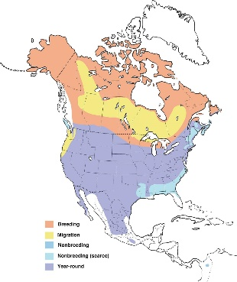
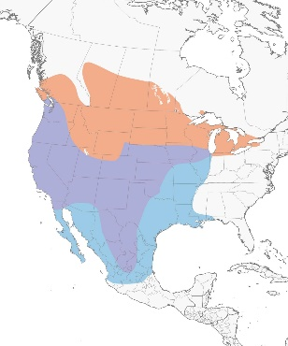
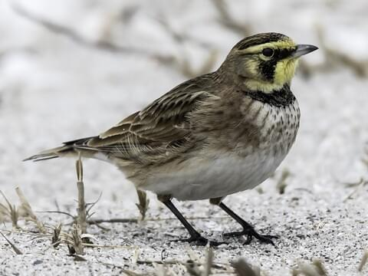
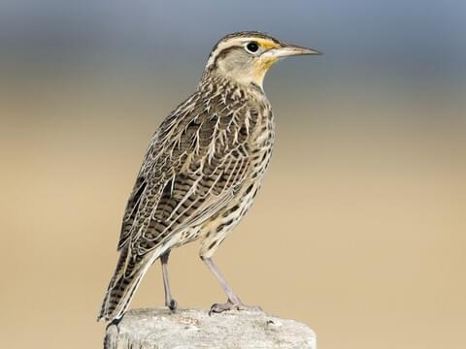
Common Birds of Rees TA
Passerines
horned lark
Eremophila alpestris
Western meadowlark
Sturnella neglecta
6-8”
6-10”
Small, long-bodied
Horizontal posture
Active, social
Forage on ground
Year-round
Robin-sized, chunkier, short tail
Long, slender bill
Yellow underparts, black “V” on breast
Winter in large flocks
Males can be found singing atop posts, bushes, fences, etc.

Slide 7
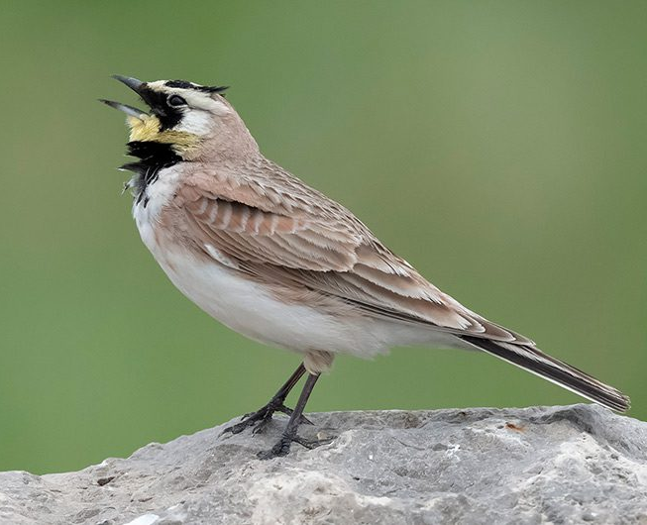
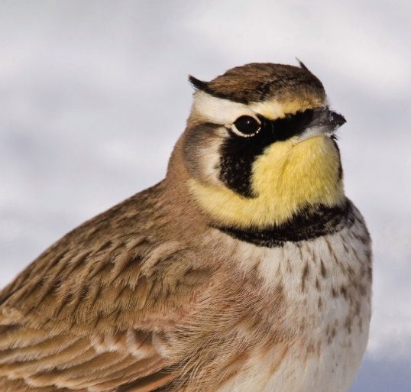
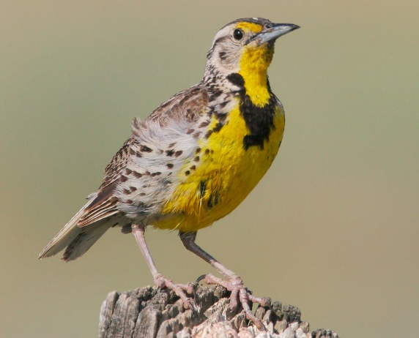
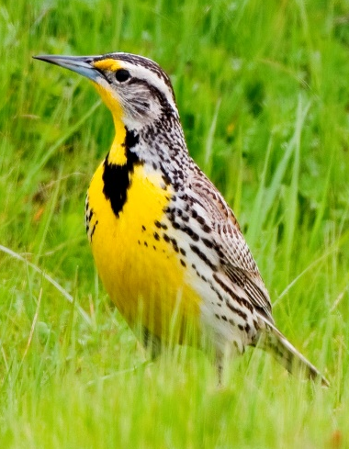
Common Birds of Rees TA
Passerines
horned lark
Eremophila alpestris
Western meadowlark
Sturnella neglecta
SONGS
Horned larks sing a delicate, musical song particularly in the early morning as early as an hour and a half before sunrise. It’s a fast, high-pitched sequence of sharp, tinkling notes, often rising in pitch to a quick jumble of concluding notes. Songs are typically a couple of seconds long but may go on for more than a minute. Males usually sing from a post, rock, clod, mound or other perch, but may sing on the wing, from a height of up to about 800 feet in the air.
CALLS
The Horned lark’s typical call, most often heard in fall and winter, is a high, piercing one- or two-note chip.
SONGS
Male Western meadowlarks have a complex, two-phrase “primary” song that begins with 1–6 pure whistles and descends to a series of 1–5 gurgling warbles. Males develop a repertoire of up to a dozen songs. When chasing competing males or responsive females, male Western meadowlarks give a hurried, excited “flight song” of short-spaced whistles and warbles.
CALLS
The Western meadowlark’s most common call is a low, bell-like pluk or chupp which they use when disturbed and during courtship and territorial displays

Slide 8
Common Birds of Rees TA
Passerines
Western meadowlark
grasshopper sparrow
Brewer’s sparrow
lark sparrow
Western kingbird
sage thrasher
horned lark

Slide 9
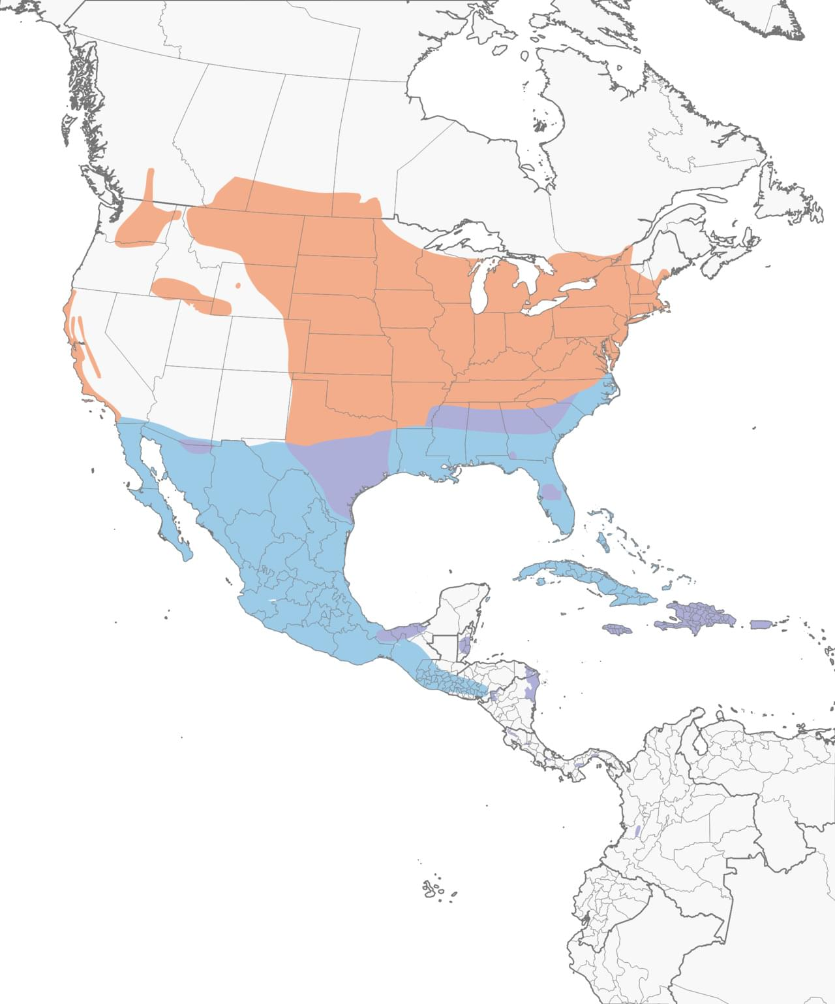
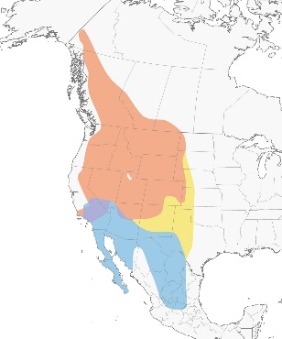
Common Birds of Rees TA
Passerines
grasshopper sparrow
Ammodramus savannarum
Brewer’s sparrow
Spizella breweri
4-4.5”
5-6”
Small, compact shape
Large head, long legs
Secretive, typically stay close to ground
Size of a chickadee
Long, notched tail, sharp conical bill

Slide 10
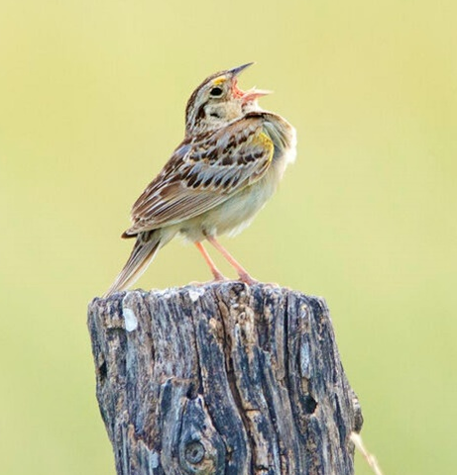
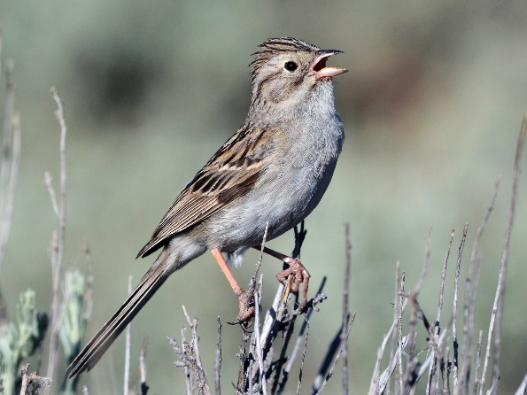
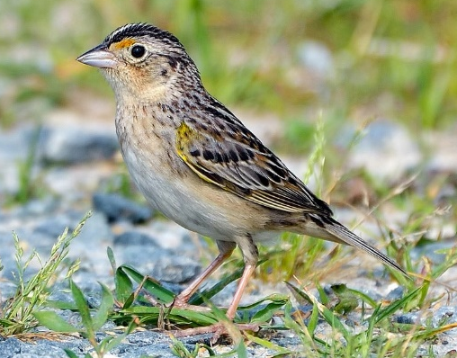
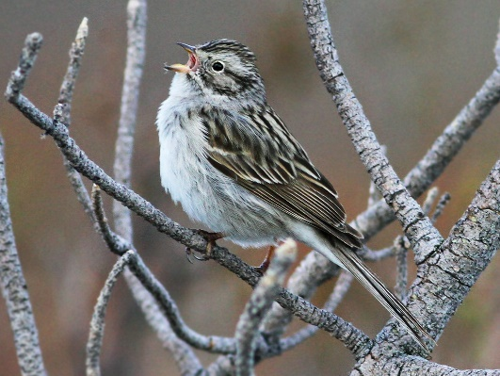
Common Birds of Rees TA
Passerines
grasshopper sparrow
Ammodramus savannarum
Brewer’s sparrow
Spizella breweri
SONGS
As their name would suggest, grasshopper sparrow’s typical song is a thin, insectlike buzz preceded by two to three ticking chips, tick tick pzzzzzzzz.
CALLS
The main call note is a high-pitched seet. They also make a series of staccato two-parted tiddick notes when alarmed.
SONGS
Male Brewer’s sparrows sing dry, trilling songs that sounds like buzzing and like a melodic insect. Songs last 1.5 to 3 seconds and typically consist of 2 trilled sections, with the first usually being faster and higher pitched.
CALLS
Call is a soft tsip or seep, similar to other Spizella sparrows. Females give soft twittering calls when soliciting courtship feeding or copulation from males.

Slide 11
Common Birds of Rees TA
Passerines
Western meadowlark
grasshopper sparrow
Brewer’s sparrow
lark sparrow
Western kingbird
sage thrasher
horned lark

Slide 12
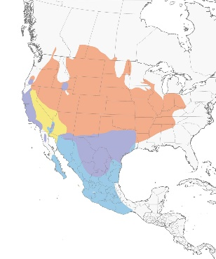
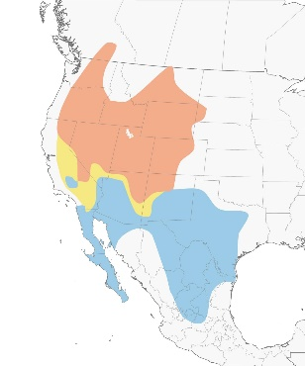
Common Birds of Rees TA
Passerines
lark sparrow
Chondestes grammacus
sage thrasher
Oreoscoptes montanus
6-7”
8-9”
Large, long-tailed sparrow
When perched, long-bodied and with thin neck, round head
Distinctive bold chestnut and white facial stripes
Lookalike: chipping sparrow – possible, but likely wrong habitat
Typical thrasher head and body, though smaller, with a shorter, straighter bill
Long tail
Overall gray with spotted underparts
Upright, tail flicking

Slide 13
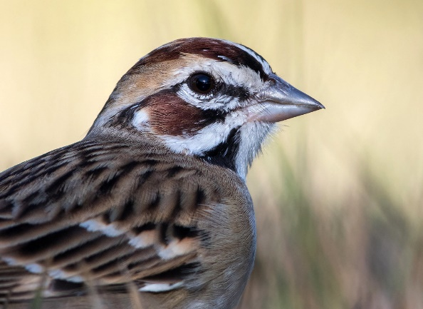
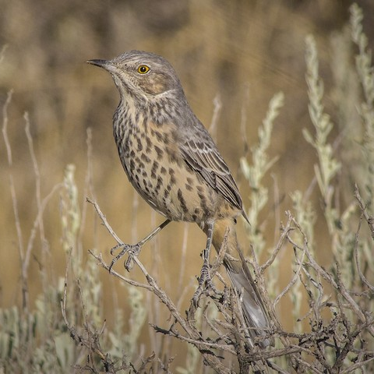
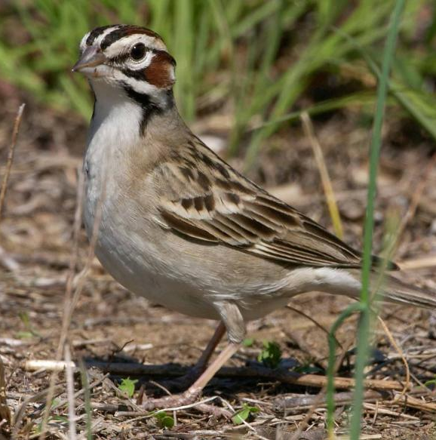
Common Birds of Rees TA
Passerines
lark sparrow
Chondestes grammacus
sage thrasher
Oreoscoptes montanus
SONGS
Male lark sparrows sing a melodious jumble of clear notes and trills interspersed with harsh buzzes and churrs. The song generally starts with a short buzz followed by 1–3 clear notes, then a few notes at a lower pitch, and finally a clear trill; they often switch up the order of the notes. Listen for the short buzzes within the jumble to help identify the song.
CALLS
Both male and female lark sparrows give a sharp metallic tink.
SONGS
Males have long, complex, melodic songs, with remarkable variety. The rambling series of phrases, often preceded by soft clucking notes, is continuous and interspersed with moments of repetition and mimicry. Songs can be very long indeed; one male was recorded singing for 22 minutes straight.
CALLS
When alarmed, call is a low, hoarse cluck, very similar to a Red-winged Blackbird, accompanied by a flick of the tail.

Slide 14
Common Birds of Rees TA
Passerines
Western meadowlark
grasshopper sparrow
Brewer’s sparrow
lark sparrow
Western kingbird
sage thrasher
horned lark

Slide 15
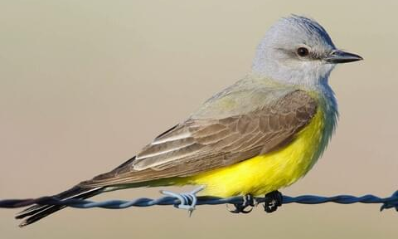
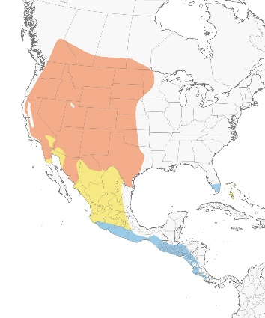
Common Birds of Rees TA
Passerines
Western meadowlark
grasshopper sparrow
Brewer’s sparrow
lark sparrow
Western kingbird
sage thrasher
horned lark
SONGS
Though it’s not technically in the group of birds known as songbirds, the Western Kingbird has one call that functions as a song. Their song is a rising series of sharp kips, culminating in a frantic burst of loud descending notes. Each call lasts about 2 seconds, and the male may repeat the pattern for half an hour to proclaim his territory.
CALLS
Western Kingbirds give sharp kip notes and squeaky twitters.
Relatively large flycatchers
Heavy, straight bills
Long, square-tipped tail
Gray head, white/gray throat, yellow belly, conspicuous white outer tail feathers

Slide 16
Common Birds of Rees TA
horned lark
Western meadowlark
grasshopper sparrow
Brewer’s sparrow
rock pigeon
lark sparrow
Western kingbird
sage thrasher
California quail
mourning dove
red-tailed hawk
American crow
common raven
Swainson’s hawk
burrowing owl
long-billed curlew

Slide 17
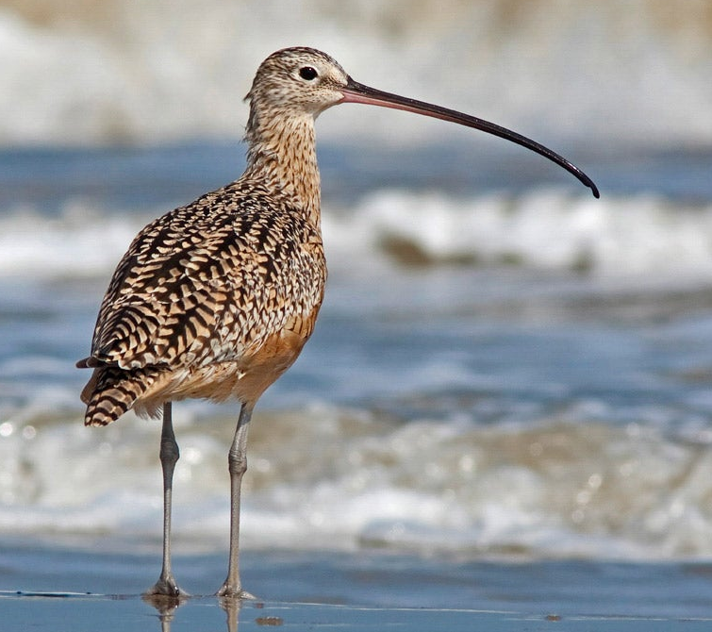
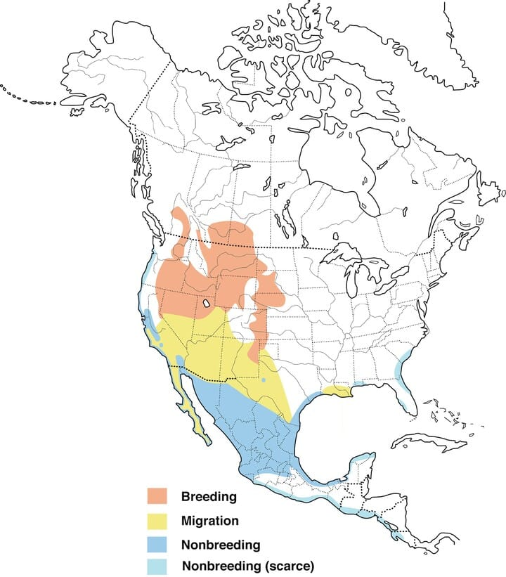
Common Birds of Rees TA
Shorebirds
long-billed curlew
Numenius americanus
Wintering
Breeding

Slide 18
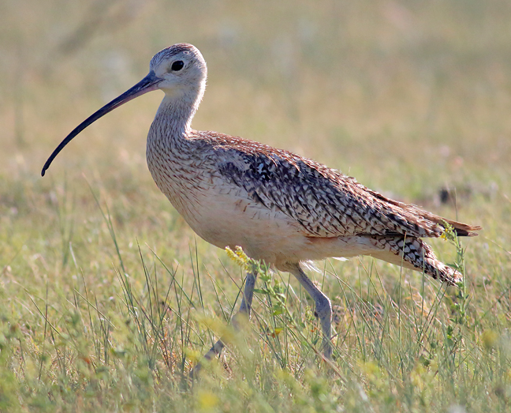
Common Birds of Rees TA
Shorebirds
SONGS
Song starts with a low whistled prreee and builds into a louder prprprprpr prrreeep prrreeep prrreeerr.
CALLS
The alarm and contact call of male and female Long-billed Curlews is a harsh whistled cur-lee, rising on second note; given year-round. They also give a rapid whistled tremolo with a slight stuttering quality to it.
20-25”
Larger than a whimbrel, smaller than an egret
M and F nest switch at dawn and dusk
Lookalike: whimbrel – outside of range/ habitat
Notes:
Football shaped body, long neck, small round head
M- shorter bill, more continuously curved
F- longer bill, curves at end
Lookalike- whimbrel out of range

Slide 19
Common Birds of Rees TA
horned lark
Western meadowlark
grasshopper sparrow
Brewer’s sparrow
rock pigeon
lark sparrow
Western kingbird
sage thrasher
California quail
mourning dove
red-tailed hawk
American crow
common raven
Swainson’s hawk
burrowing owl
long-billed curlew

Slide 20
Common Birds of Rees TA
Raptors
red-tailed hawk
Swainson’s hawk
burrowing owl

Slide 21
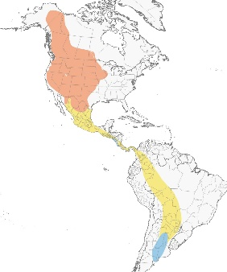
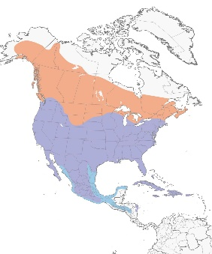
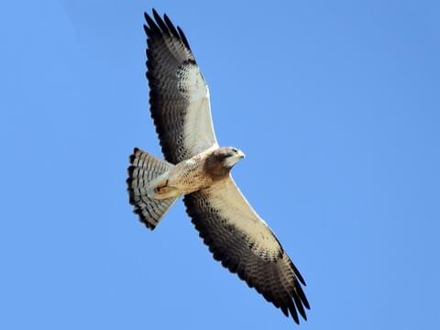
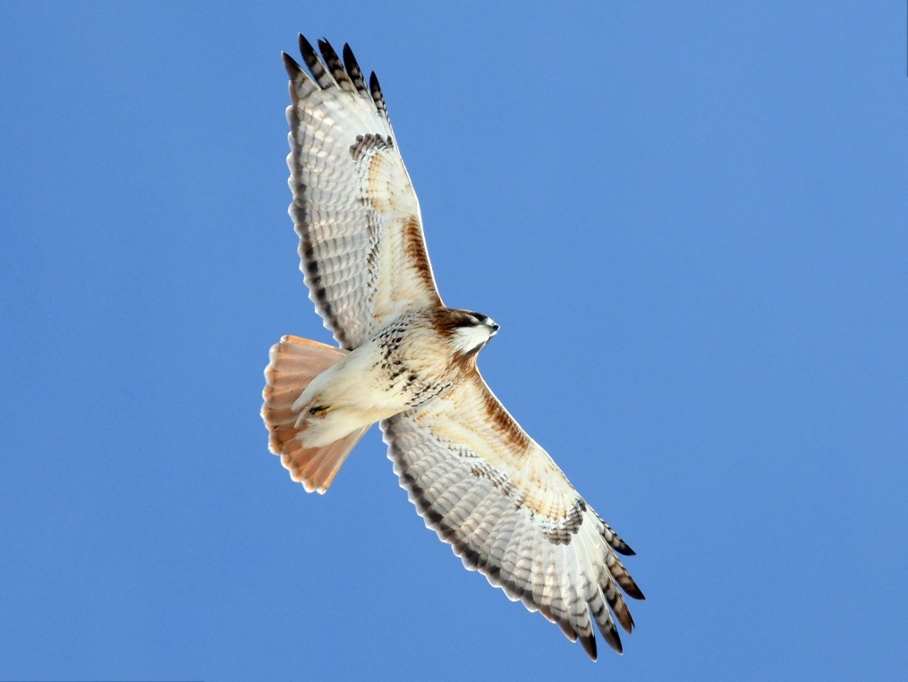
Common Birds of Rees TA
Raptors
red-tailed hawk
Buteo jamaicensis
Swainson’s hawk
Buteo swainsoni
Dark patagial marks
Dark hood extending onto chest
Dark belly band
White wing linings
Dark flight feathers

Slide 22
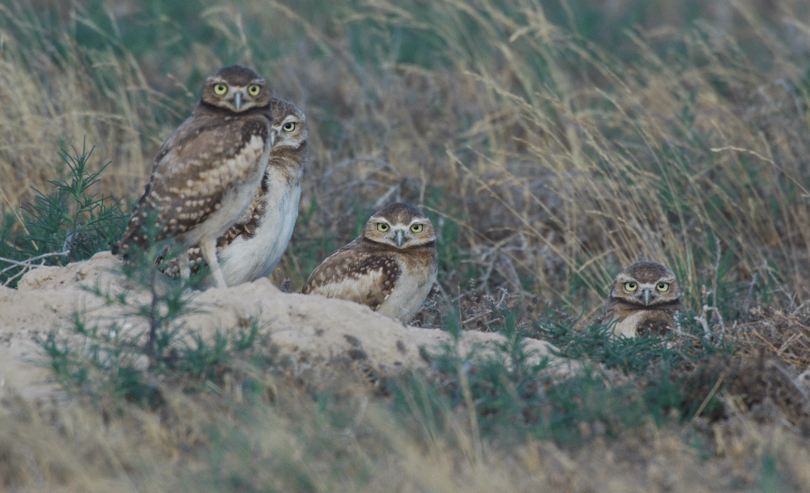
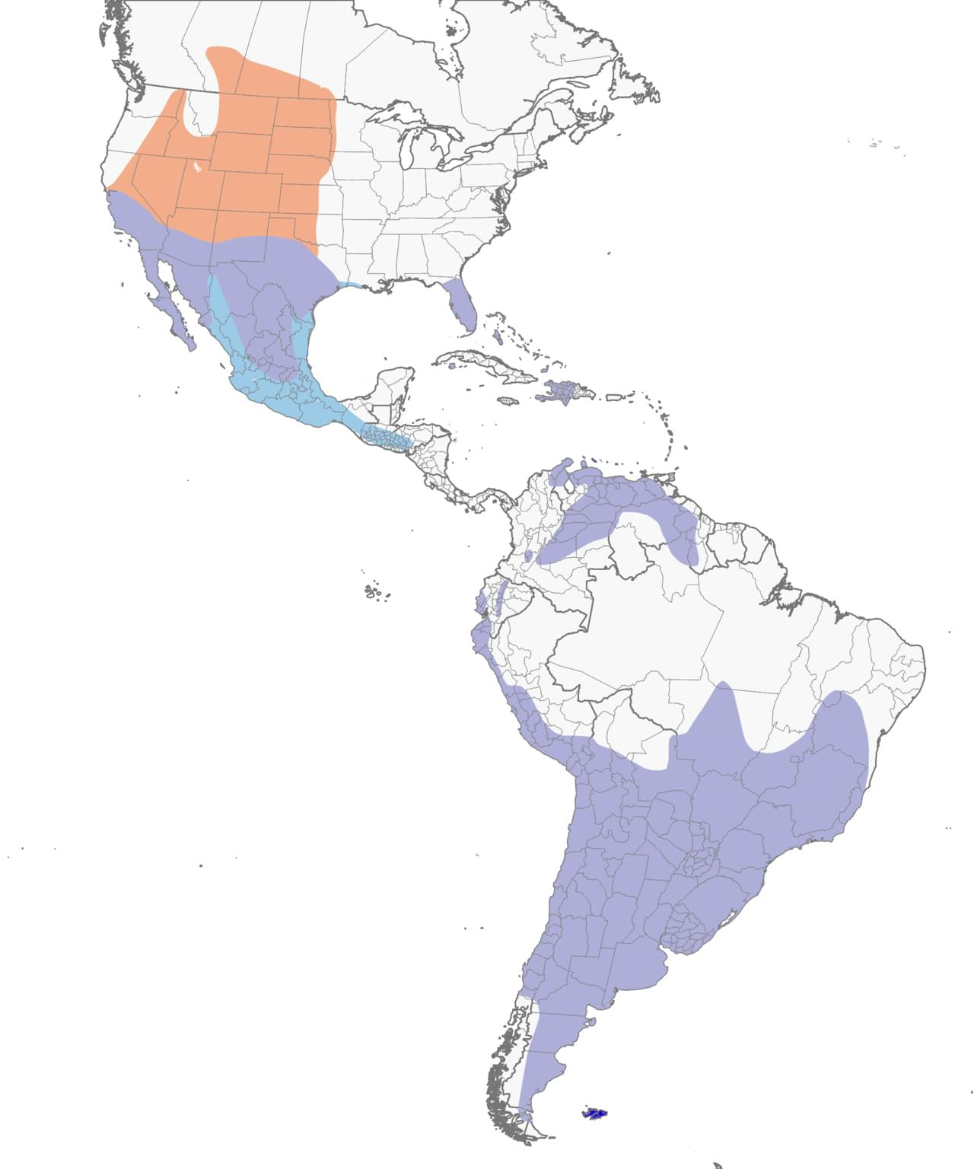
Common Birds of Rees TA
Raptors
burrowing owl
Athene cunicularia

Slide 23
Common Birds of Rees TA
Raptors
CALLS
Burrowing owls are capable of producing a variety of cooing, warbling, rasping, clucking, and rattling sounds. Most commonly heard is a quail-like two-note cooing. Adults make raspy cheeck alarm calls. Young owls utter eep calls and rasping sounds, the most intense and prolonged of which may scare away predators by mimicking a rattlesnake's warning.
7.5-10”
Small owls with long legs
Round head with no tufts
Secondary burrow users, spend most time on or close to the ground
Active during the day

Slide 24
Common Birds of Rees TA
horned lark
Western meadowlark
grasshopper sparrow
Brewer’s sparrow
rock pigeon
lark sparrow
Western kingbird
sage thrasher
California quail
mourning dove
red-tailed hawk
American crow
common raven
Swainson’s hawk
burrowing owl
long-billed curlew

Slide 25
Common Birds of Rees TA
horned lark
Western meadowlark
grasshopper sparrow
Brewer’s sparrow
rock pigeon
lark sparrow
Western kingbird
sage thrasher
California quail
mourning dove
red-tailed hawk
American crow
common raven
Swainson’s hawk
burrowing owl
long-billed curlew

Slide 26
Oregon Army National Guard (ORARNG)
Questions?

