Slide 1
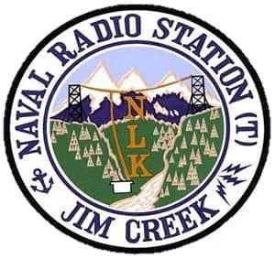
Monitoring for Marbled Murrelet and Northern Spotted Owl at Naval Radio Station Jim Creek
with Implications for Future Marbled Murrelet Surveys
Adam Duarte¹, Alicia M. Higgs², Alaina D. Thomas¹, Damon B. Lesmesister¹
1. USDA Forest Service, Pacific Northwest Research Station
2. Naval Facilities Engineering Systems Command, Naval Station Everett

Slide 2
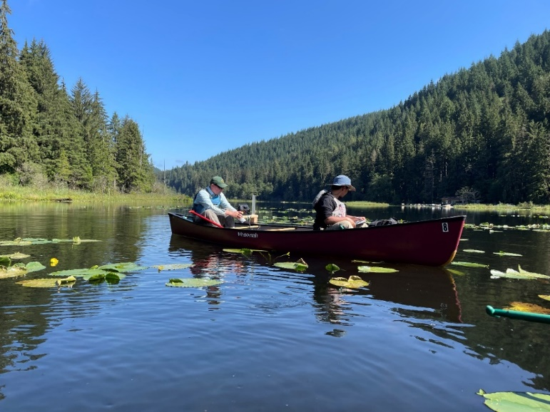
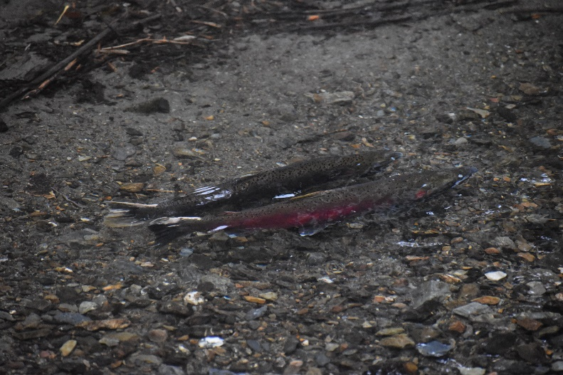
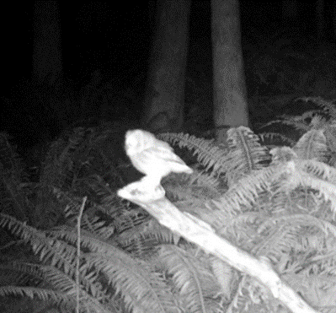
DoD Natural Resources Management Program
Sikes Act - the conservation and rehabilitation of natural resources on military installations
Requires Integrated Natural Resources Management Plan (INRMP)
Notes:
INRMP is intended to ensure the sustainability of ecosystems that encompass the installation; and
ensure no net loss in the capability of installation lands to support the military mission at NRS(T) Jim Creek
Describes how the Navy will protect habitats and species, and implementation plan for natural resources projects, including: spawning surveys, pika surveys, bat surveys, wildlife cameras, forestry/wildfire reduction projects, aquatic habitat study at Twin Lakes, environmental education, riparian habitat restoration and invasive plant removal.

Slide 3
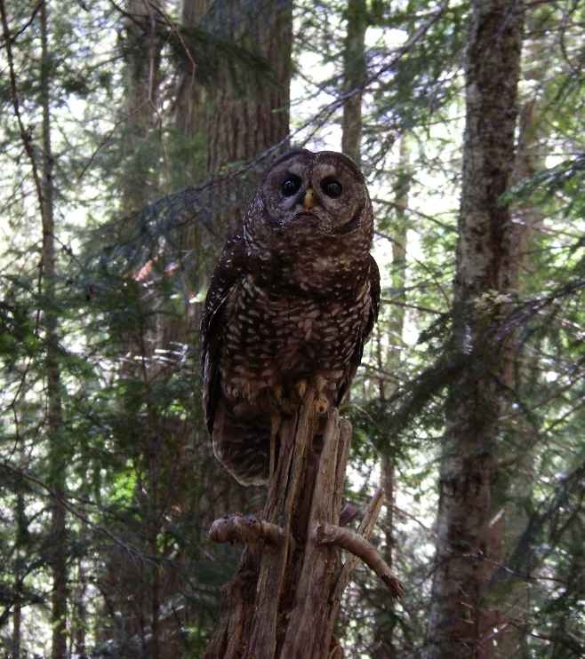
DoD Natural Resources Management Program
Marbled Murrelet
(MAMU)
Brachyramphus marmoratus
ESA threatened
Northern Spotted Owl (NSO)
Strix occidentalis caurina
ESA threatened
Notes:
Navy must survey for species listed under the Endangered Species Act, including Marbled Murrelet and Northern Spotted Owl
Marbled murrelet – sea bird that nests in mature and old-growth forests. Previously documented at Jim Creek.
Northern spotted owl – large home ranges in mature and old-growth forests, now rare in WA and would not be expected at Jim Creek given the patchwork of forest surrounding the installation

Slide 4
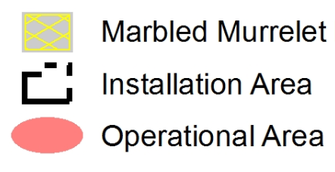
Study Area: NRS(T) Jim Creek
Very low frequency radio transmitter
Recreation area
Old-growth forest conservation area
Critical Habitat
Notes:
4,800-acre installation near Arlington, WA
VLF radio transmitter for communication with Pacific Fleet, primary purpose
Navy recreation program for active duty, retired, and civilian DoD personnel
Contains mature and old-growth forests, particularly in the Twin Lakes/Cub Creek drainage. Some of the largest remaining old-growth spruce and cedar forest in the Puget Sound trough.
MAMU critical habitat was designated within the installation in the location of this older forest.

Slide 5
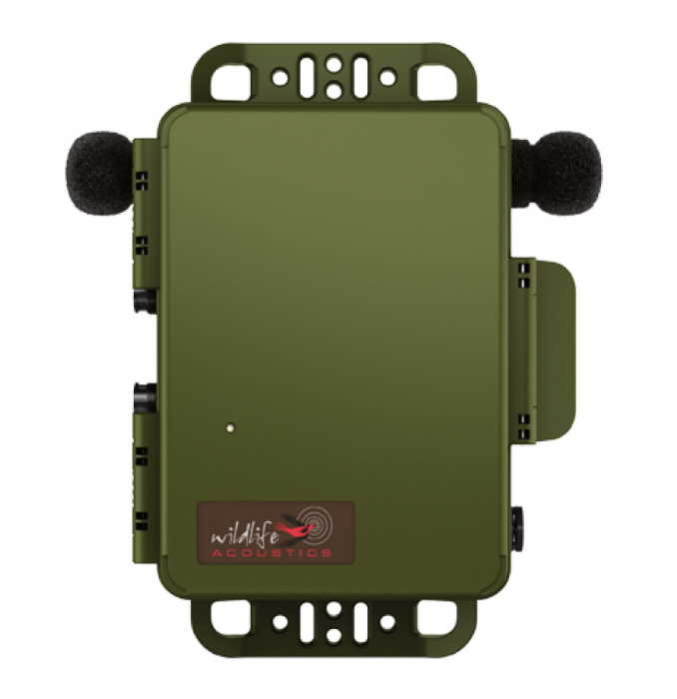
Study Objectives
Determine NSO and MAMU status
Compare detectability of MAMU
Standard AV surveys
Passive acoustic monitoring

Slide 6
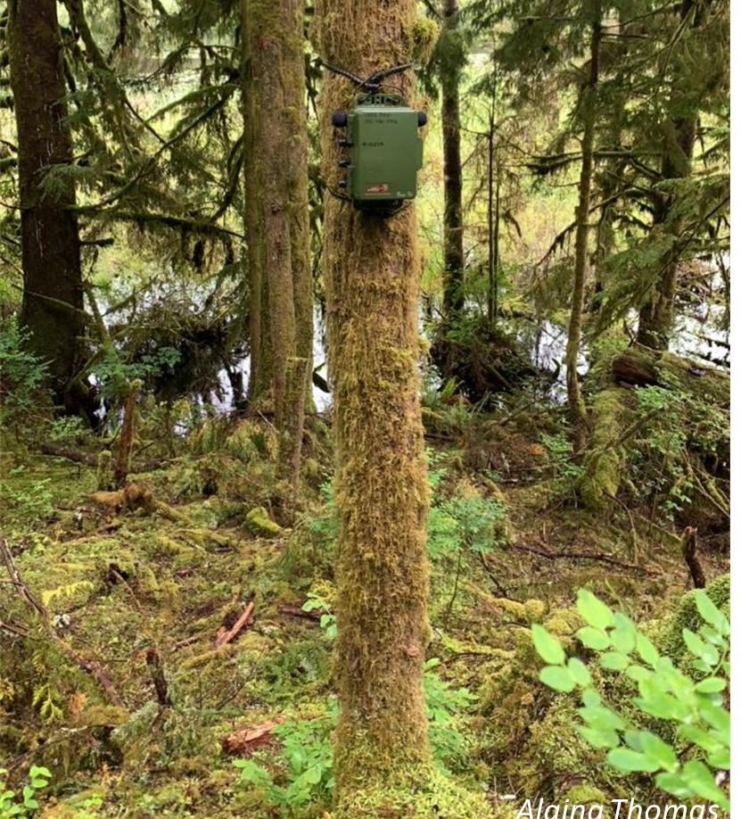
Passive Acoustic Surveys
Pros:
Detect whole suite of vocalizing species
Permanent record
Monitor many sites at once over longer periods
Detect rare or cryptic vocalizing species
Cons:
Storing, processing, validating many hours of sound data
At mercy of technology

Slide 7
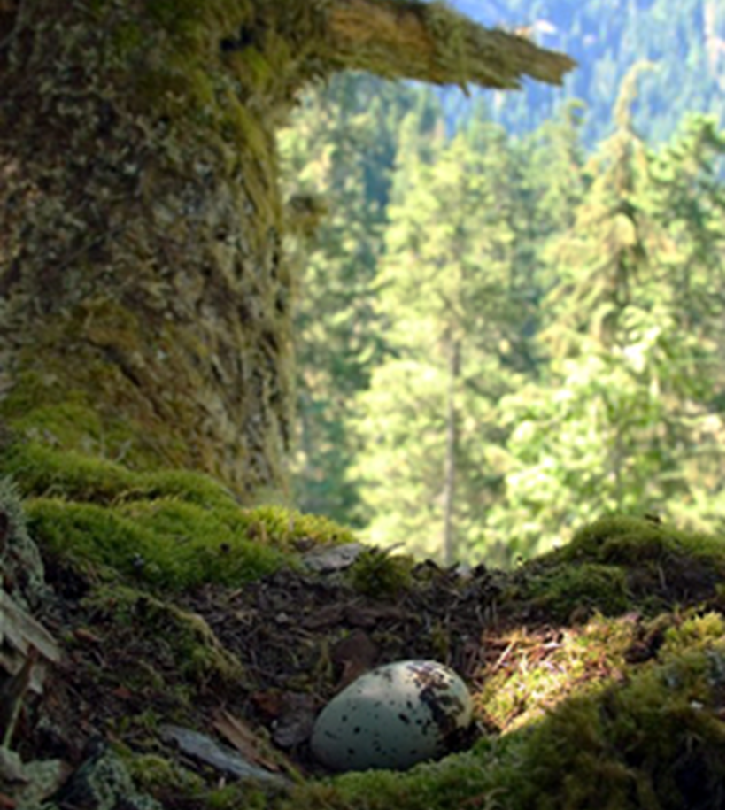
Audio-visual Surveys
Pros
Detect vocalizations and flight behavior for MAMU
Cons
Navigate to site in dark, early mornings
At mercy of weather and technician availability, ID skill, and attention span

Slide 8
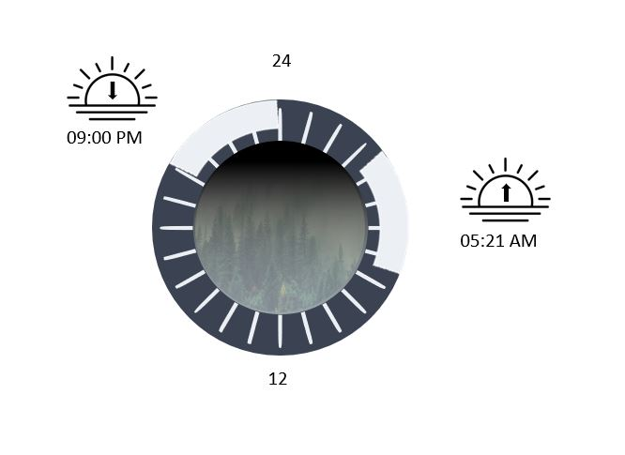
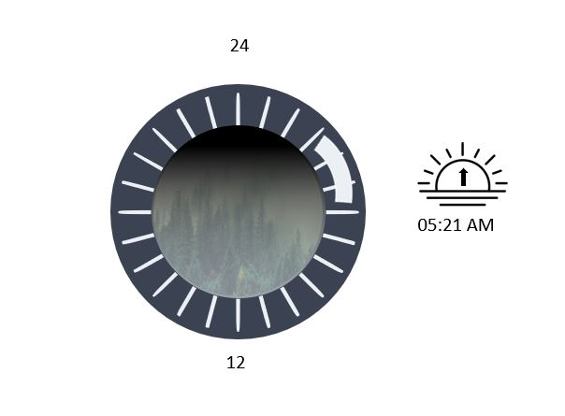
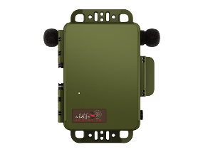
Survey Design
Passive Acoustic
Within 10m of the audio-visual survey station
Throughout study area
39 total stations
Audio-visual Surveys
Pacific Seabird Group (inland forest survey protocol)
19 stations throughout quality MAMU nesting habitat
June 14 – Aug 5, 2022

Slide 9
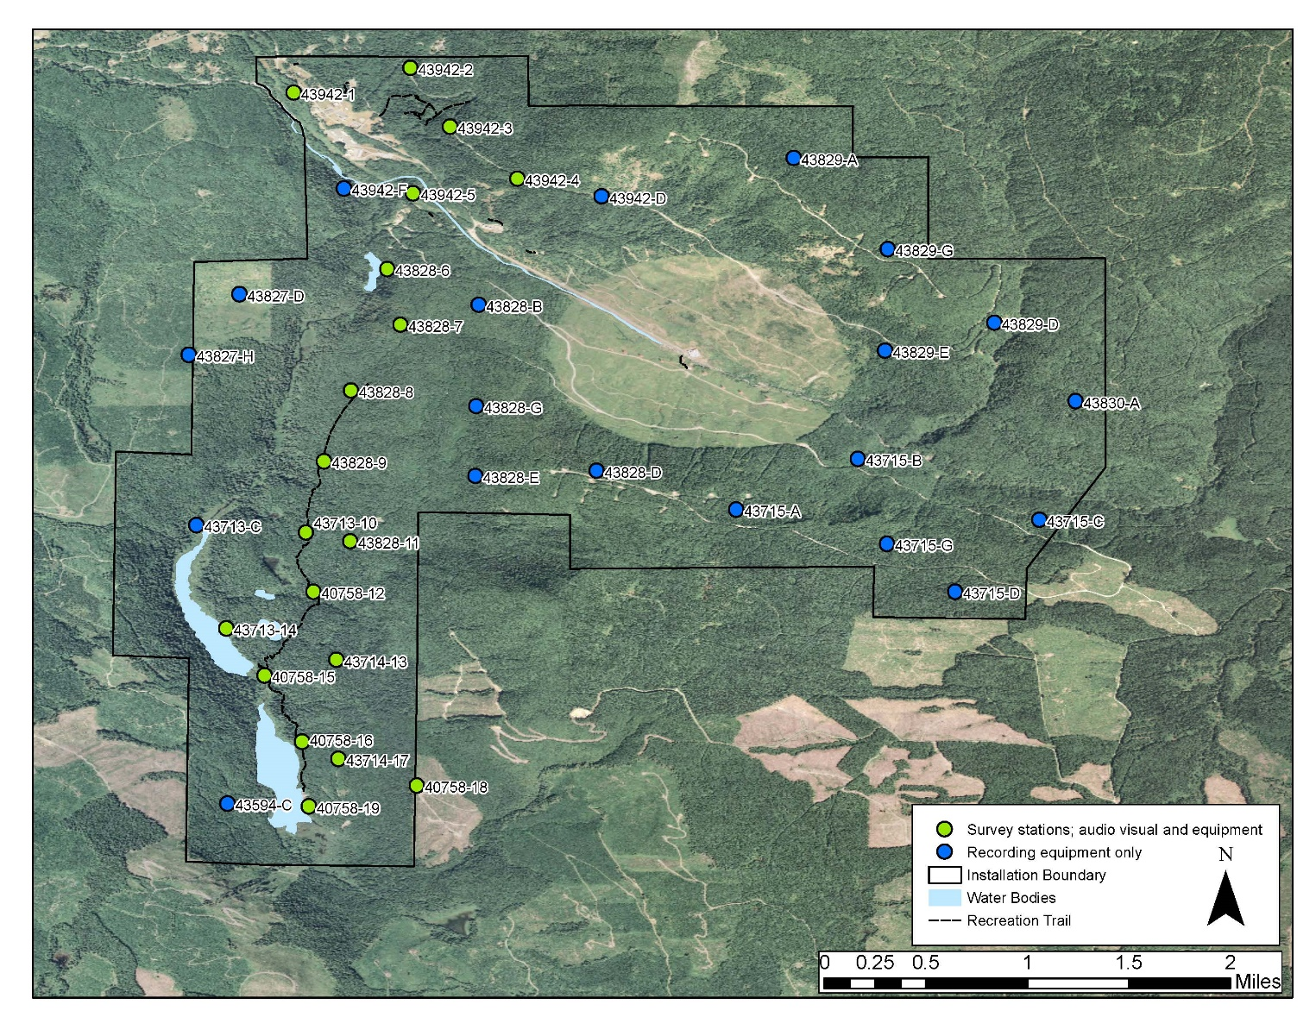
Survey Design

Slide 10
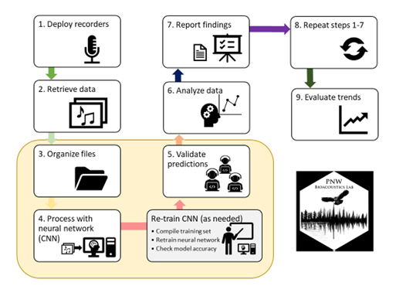
Audio Data Analyses
PNW C-net v4
Prediction thresholds
≥0.95 for MAMU keer calls
≥0.25 for NSO location calls

Slide 11
Results
Passive Acoustic
39 total stations
Aimed for 6 week deployments
Days fully operational averaged 46.7
(range: 13–64)
Recorded 1,840,970.24 total hours
Range across stations: 133.00–664.86 hours
Approximately 4.74 Tb of audio data
No detections of NSO
BADO detected at 38 stations
MAMU detected at 24 stations
573 total detections
Audio-visual Surveys
19 total stations
Replicate surveys
70 total surveys
2–5 replicate surveys per station (avg. = 3.68)
MAMU detected at 10 stations
88 total detections

Slide 12
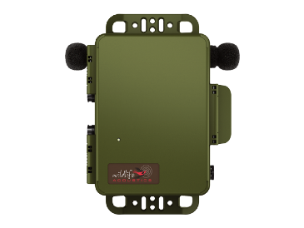
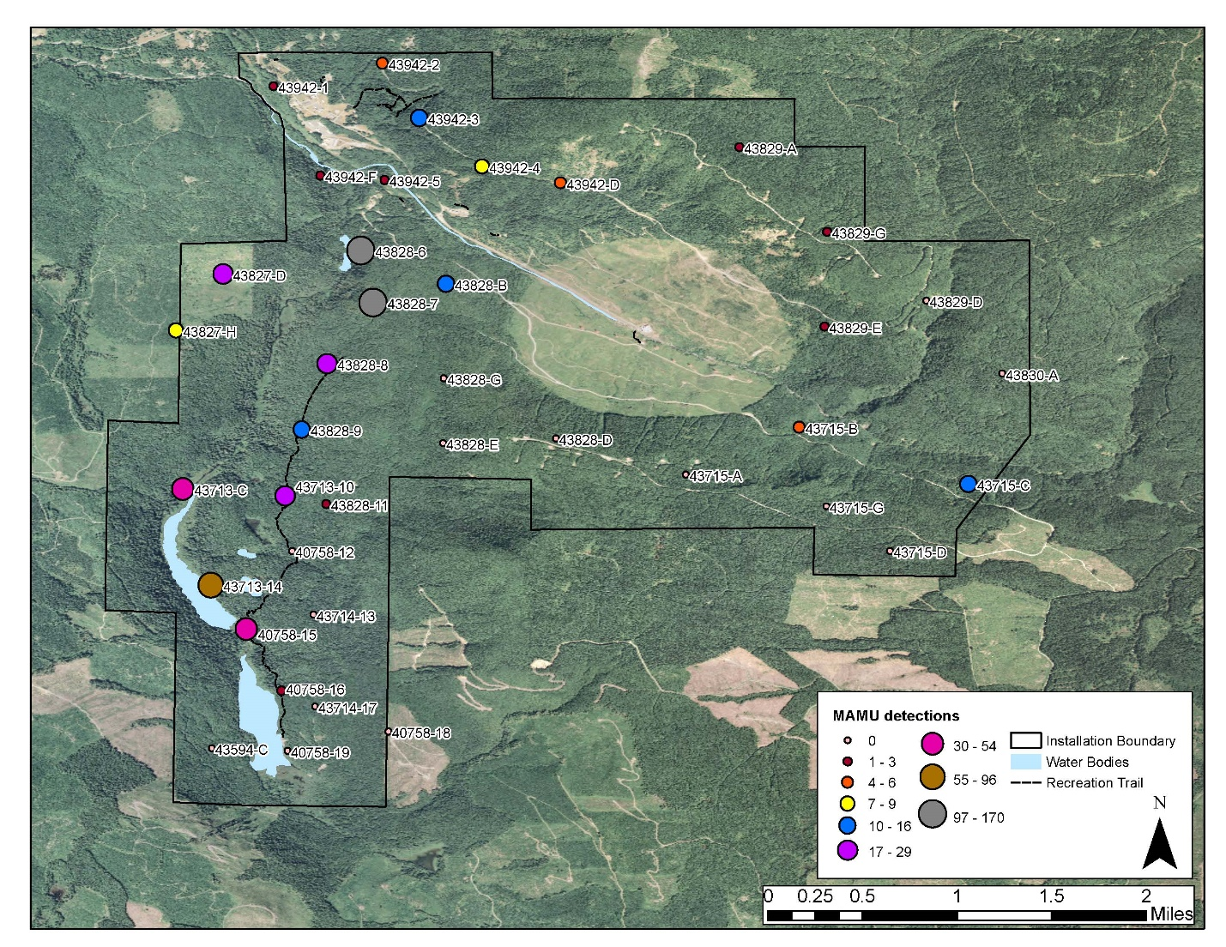
Passive Acoustic MAMU Detections

Slide 13
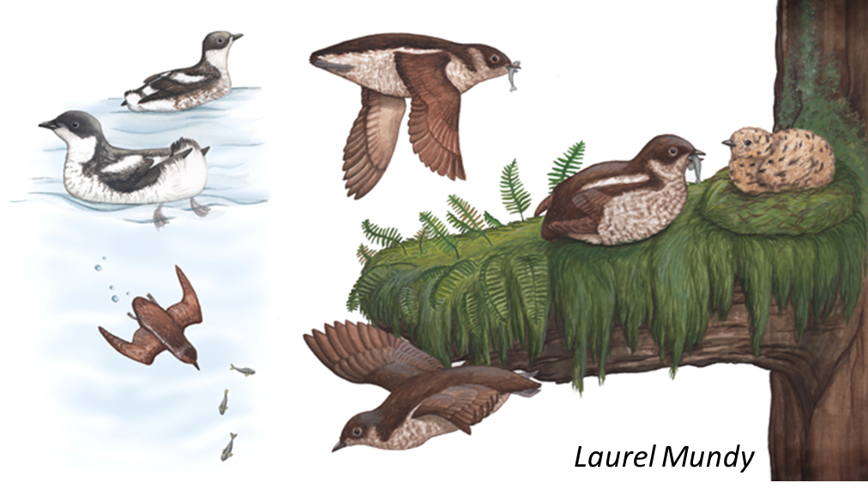
Audio-visual Survey MAMU Detections
88 total detections across 10 stations
69 were auditory
Visual detections
4 flying over the canopy
1 circling over the canopy
8 circling at or below canopy
6 flying through at or below canopy

Slide 14
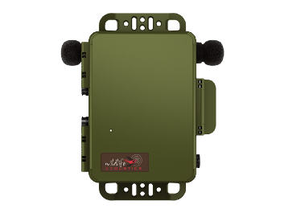
Comparing MAMU Detections
AV surveys
MAMU status
4 stations MAMU Occupied
6 stations MAMU Present
9 stations MAMU Not Detected
Missed 7 at least MAMU Present
Passive acoustic
Never missed MAMU Occupied
Missed 3 MAMU Present
 | Detected | Not detected
Detected | 7 | 7
Not detected | 3 | 2

Slide 15
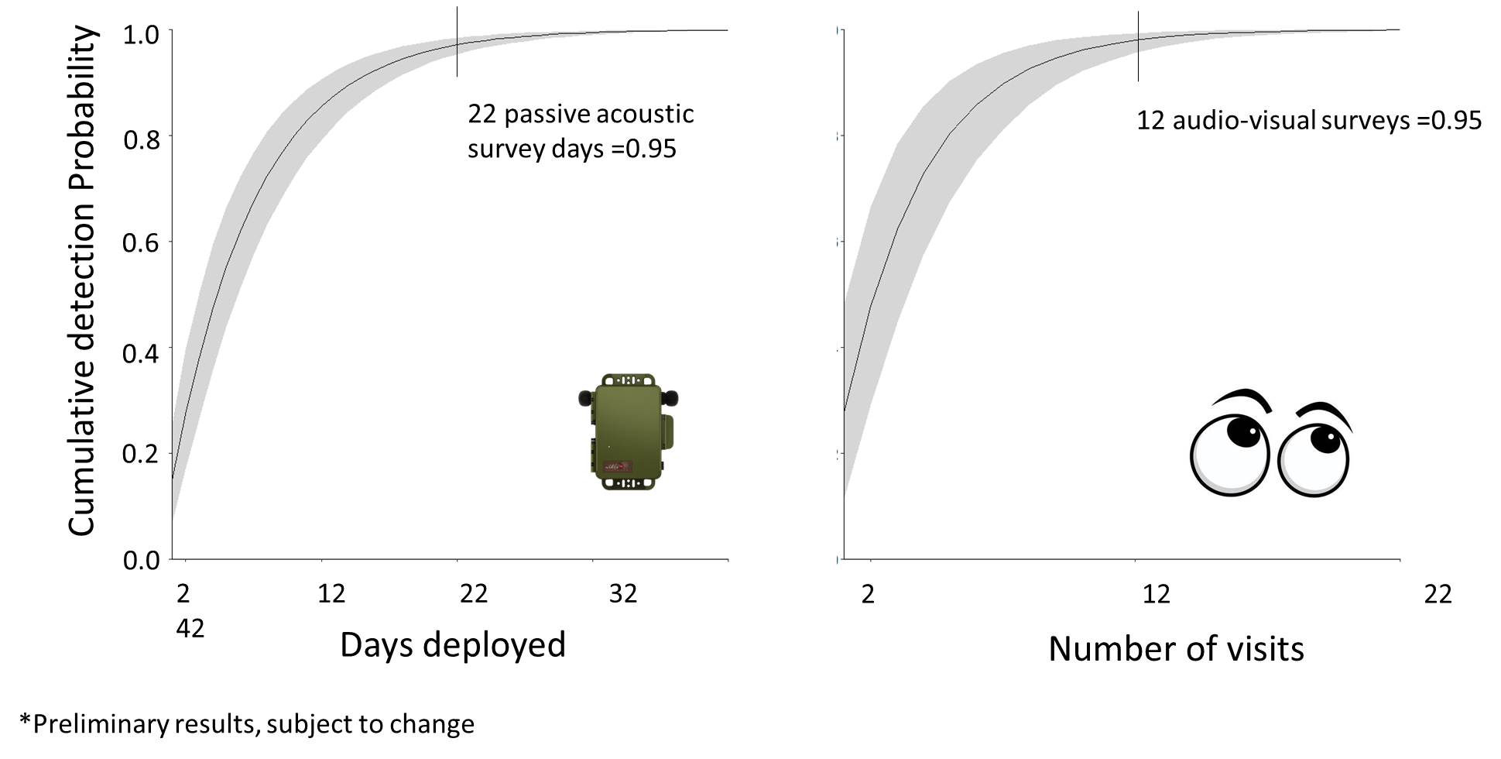
Implications for Future MAMU Surveys

Slide 16
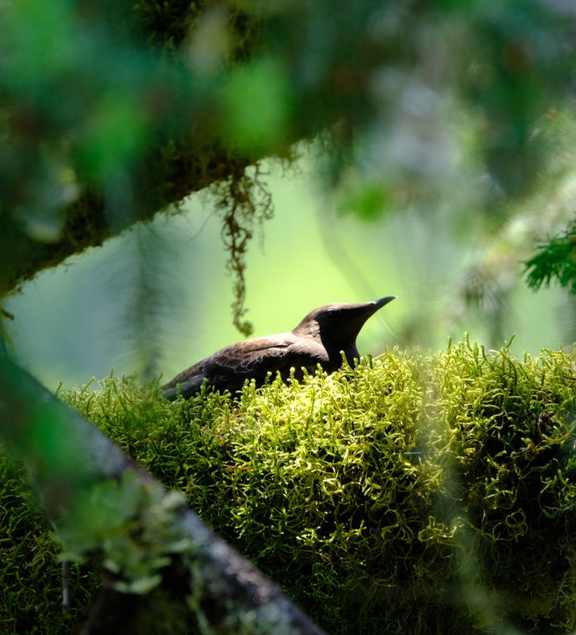
Management Implications
Ensure Navy activities are implementing minimization measures
esp near MAMU hotspots
Habitat enhancement through forestry projects
Contribute to advancing science and conservation of this species
Brett Lovelace / Oregon State University
Notes:
Supports the Recovery and Sustainment Program (RASP) initiative the Navy signed with USFWS. Purpose is implementing priority conservation actions to promote recovery of the marbled murrelet, designated critical habitat, and forage fish.

Slide 17
Thank you!
Mapping, field support, surveyors, and validation:
Juliana Jenkins | Bryan Begay
Sean Gee | Tom Munger
Nicole Mutchler | Jacob Schmidt
Natalie Rugg

Slide 18
Questions/Comments?
Adam Duarte
Email: adam.duarte@usda.gov
Alicia Higgs
Email: alicia.m.higgs.civ@us.navy.mil

